Slide 1
Object Oriented
Design
Tony Baines
March 2013

Slide 2
Introduction
What this is not
  A Methodology
    I have nothing to sell you
  A Process
    If it was repeatable, the computers would do it
… but it will be
  A vocabulary for talking about design
  Some principles for spotting good (and bad) design

Slide 3
What do you think of When you think of OO?
Inheritance
Data and Methods
Encapsulation
Polymorphism
Coupling
Cohesion

Slide 4
Context
We build systems to solve a problem
We write (design) software to talk to other people
  The CPU doesn't care about style
  Communicating intent in code is hard
    A kind of mind-reading
    Object Orientation is a mindset for humans
    Good OO projects the understanding of the team

Slide 5
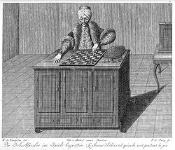
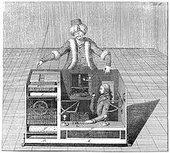
Foundation Concepts
Encapsulation
State and Operations together
Messages go in
Messages come out
How does it work?
Notes:
A fake chess-playing machine constructed in the late 18th century by Wolfgang von Kempelen to impress the Empress of Austria, the mechanism appeared to be able to play a strong game of chess against a human opponent

Slide 6
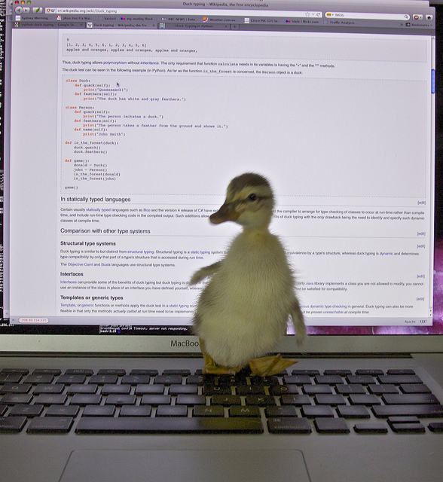
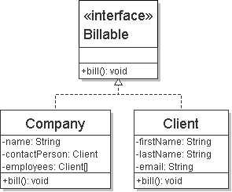
Foundation Concepts
Polymorphism
'Many Shaped'?
One shape on the outside
Different innards

Slide 7
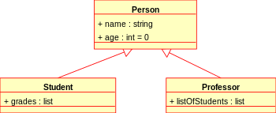
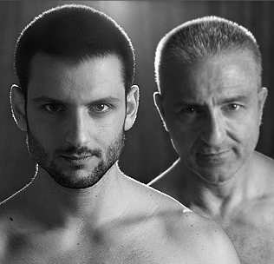
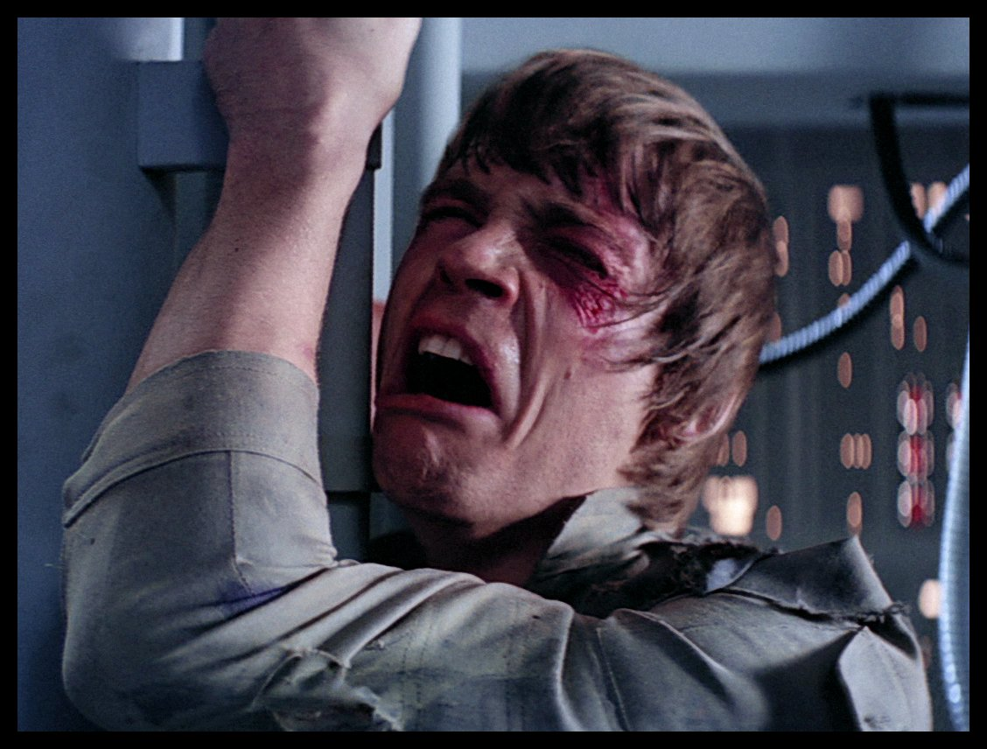
Foundation Concepts
Inheritance
“Is-A” relationship
  A cat is a mammal
Subtype-Polymorphism
  aka Sub-classing
  Reuse definitions

Slide 8
Exercise 1:
Inheritance

Slide 9
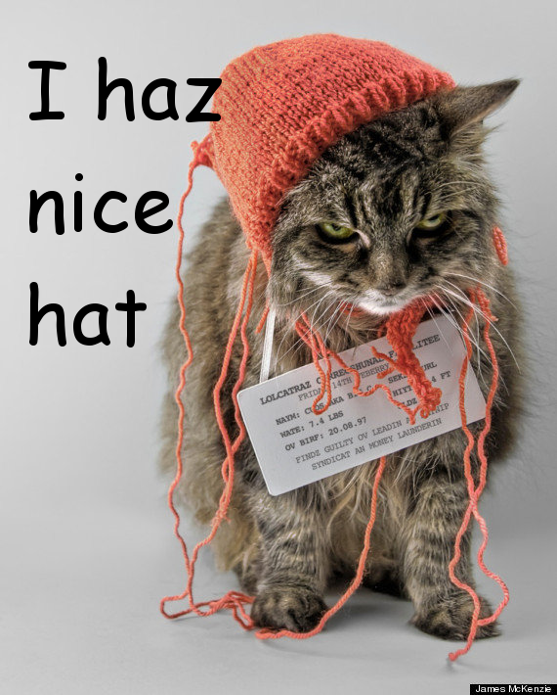

Foundation Concepts
Composition
“Has-A” relationship
  A cat has a tail
May or may not share a lifecycle

Slide 10
Exercise 2:
Composition

Slide 11
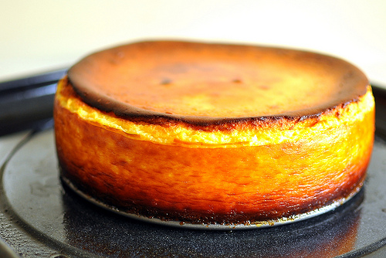
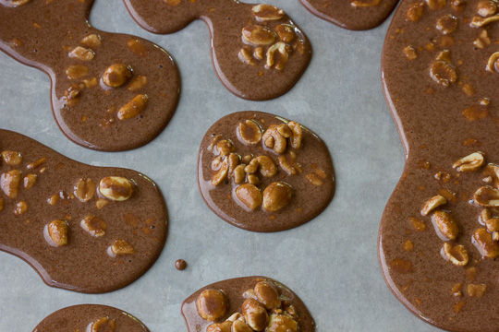
Foundation Concepts
Cohesion
Do one job
One reason to change
One concept encapsulated

Slide 12
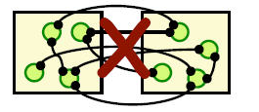
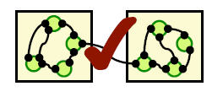
Foundation Concepts
Coupling
What do you need to get things done?
What needs you to get things done?
Trade-off against cohesion
  Zero coupling = big ball of mud
Aim to stay Loose

Slide 13
Exercise 3:
Back at the Zoo

Slide 14
Principles
The simplest thing
  that works
YAGNI
  You
  Aren't
  Going to
  Need
  It
For real applications this only works if;
  You refactor
  You have tests
Complexity is the enemy

Slide 15
A note on Complexity
“Designing software is an exercise in managing complexity”
Jim Reeve - C++ Journal (1992)
Necessary Complexity
  Solving hard problems
Accidental Complexity
  Gold plating, poor design, premature optimisation, …
Complexity is a cart full of stones, slowing us down

Slide 16
Principles
Don't Repeat Yourself
Every copy-and-paste is another stone in the cart
Two places to fix bugs
Two places to make a change
Two things to understand

Slide 17
Principles
The Principle Of Least Surprise
What would you expect from an API?
What would you hope for in the implementation?
When in doubt
  Do the right thing.

Slide 18
Principles
Single Responsibility
O
L
I
D
Do one thing
High Cohesion
DRY
A place for everything, and everything in it's place

Slide 19
Principles
S
Open Closed
L
I
D
Open for Extension
  Subclassing
  Interface implementation
Closed for modification
  Only changes if it's requirements change

Slide 20
Principles
S
O
Liskov Substitution
I
D
"New classes should be logical, consistent extensions of their super-classes"
Barbera Liskov (1987)
The client of an API shouldn't need to know about different implementations
Principle of Least Surprise

Slide 21
Principles
S
O
L
Interface Segregation
D
It's better to depend on a small interface than a large one
It's better to implement a small interface than a large one
Break large interfaces down into smaller ones

Slide 22
Principles
S
O
L
I
Dependency Inversion
High-level modules should not depend on low-level modules. Both should depend on abstractions.
Abstractions should not depend upon details. Details should depend upon abstractions.
BDD helps here
Dependency Injection helps too

Slide 23
Principles
Law Of Demeter
Formally, the Law of Demeter for functions requires that a method m of an object O may only invoke the methods of the following kinds of objects:[2]
  O itself
  m's parameters
  Any objects created/instantiated within m
  O's direct component objects
  A global variable, accessible by O, in the scope of m

Slide 24
Principles
Law Of Demeter
Principle of Least Knowledge
It's all about encapsulation, coupling & cohesion
An object should avoid invoking methods of a member object returned by another method.
Use one dot

Slide 25
Exercise 4
Cash Machine

Slide 26
Practices
Micro types
  Capture the concept of domain types
  e.g. Order ID
  update(String orderId, String reasonCode)
  update(OrderID id, Reason reason)

Slide 27
Spare Slides

Slide 28
Principles
Zero
One
Many
Will there always just be one of these?
  Yes: design for one
  No: design for many

